Slide 1
Scene Planes and Homographies class 16
Multiple View Geometry
Comp 290-089
Marc Pollefeys

Slide 2
Content
Background: Projective geometry (2D, 3D), Parameter estimation, Algorithm evaluation.
Single View: Camera model, Calibration, Single View Geometry.
Two Views: Epipolar Geometry, 3D reconstruction, Computing F, Computing structure, Plane and homographies.
Three Views: Trifocal Tensor, Computing T.
More Views: N-Linearities, Multiple view reconstruction, Bundle adjustment, auto-calibration, Dynamic SfM, Cheirality, Duality

Slide 3
Multiple View Geometry course schedule
(subject to change)
Jan. 7, 9 | Intro & motivation | Projective 2D Geometry
Jan. 14, 16 | (no class) | Projective 2D Geometry
Jan. 21, 23 | Projective 3D Geometry | (no class)
Jan. 28, 30 | Parameter Estimation | Parameter Estimation
Feb. 4, 6 | Algorithm Evaluation | Camera Models
Feb. 11, 13 | Camera Calibration | Single View Geometry
Feb. 18, 20 | Epipolar Geometry | 3D reconstruction
Feb. 25, 27 | Fund. Matrix Comp. | Fund. Matrix Comp.
Mar. 4, 6 | Rect. & Structure Comp. | Planes & Homographies
Mar. 18, 20 | Trifocal Tensor | Three View Reconstruction
Mar. 25, 27 | Multiple View Geometry | MultipleView Reconstruction
Apr. 1, 3 | Bundle adjustment | Papers
Apr. 8, 10 | Auto-Calibration | Papers
Apr. 15, 17 | Dynamic SfM | Papers
Apr. 22, 24 | Cheirality | Project Demos

Slide 4

Two-view geometry
Epipolar geometry
3D reconstruction
F-matrix comp.
Structure comp.

Slide 5
Planar rectification
(standard approach)
Bring two views
to standard stereo setup
(moves epipole to ∞)
(not possible when in/close to image)

Slide 6
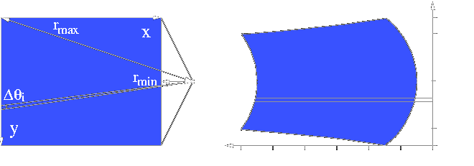
Polar rectification
(Pollefeys et al. ICCV’99)
Polar re-parameterization around epipoles
Requires only (oriented) epipolar geometry
Preserve length of epipolar lines
Choose Δθ so that no pixels are compressed
original image
rectified image
Works for all relative motions
Guarantees minimal image size

Slide 7
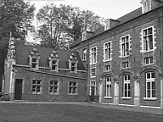
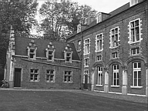
polar rectification: example

Slide 8

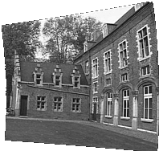
polar rectification: example

Slide 9
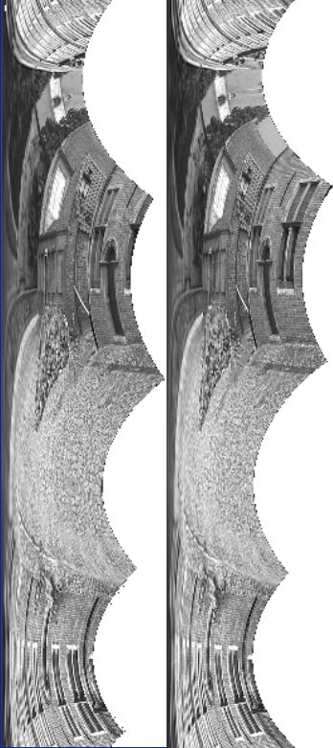
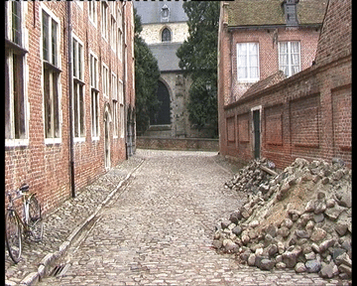


Example: Béguinage of Leuven
Does not work with standard
Homography-based approaches

Slide 10
Stereo matching
attempt to match every pixel
use additional constraints

Slide 11
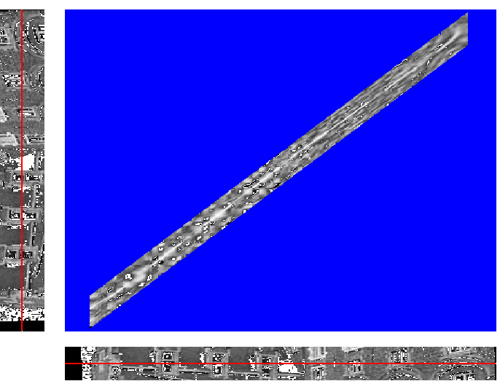
Stereo matching
Similarity measure
(SSD or NCC)
Constraints
epipolar
ordering
uniqueness
disparity limit
disparity gradient limit
Trade-off
Matching cost (data)
Discontinuities (prior)
Optimal path
(dynamic programming )
(Cox et al. CVGIP’96; Koch’96; Falkenhagen´97;
Van Meerbergen,Vergauwen,Pollefeys,VanGool IJCV‘02)

Slide 12
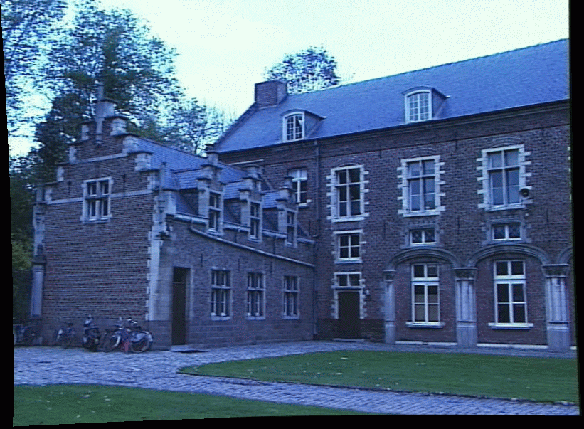
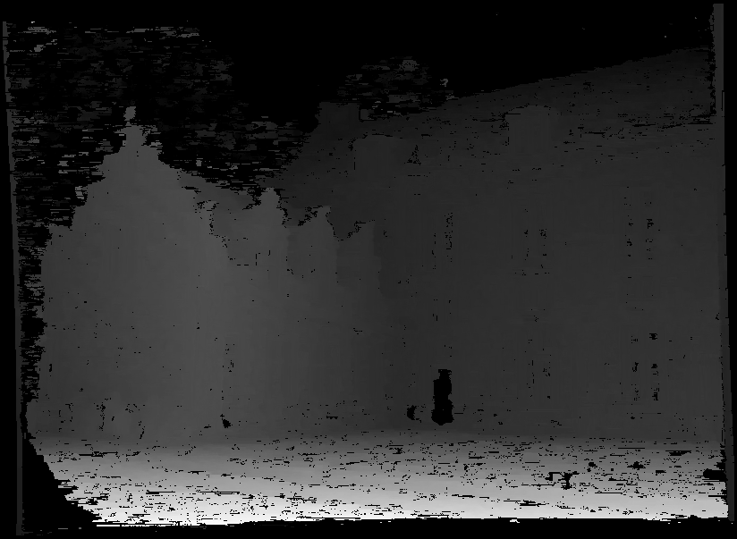
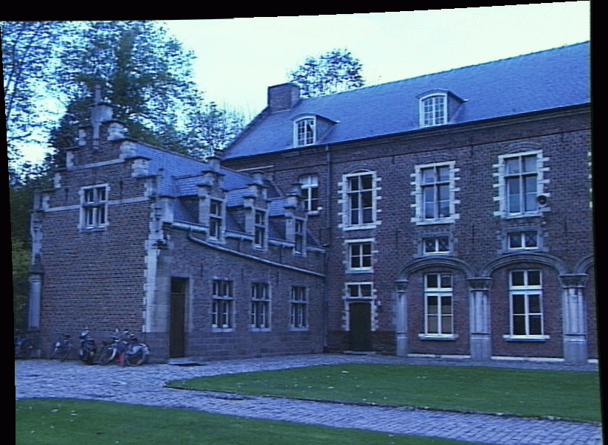
Disparity map
image I(x,y)
Disparity map D(x,y)
image I´(x´,y´)
(x´,y´)=(x+D(x,y),y)

Slide 13
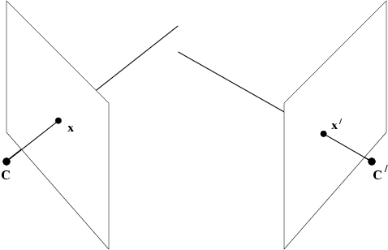


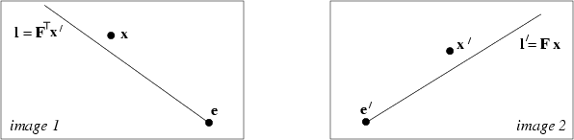
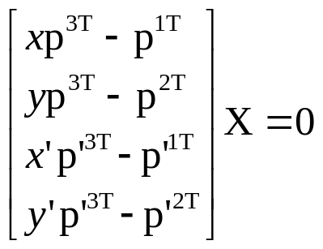
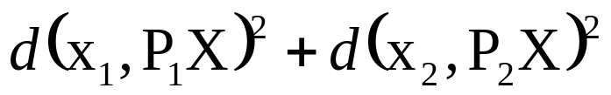
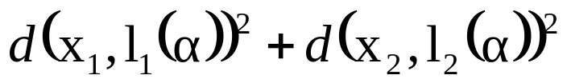
Point reconstruction

Slide 14
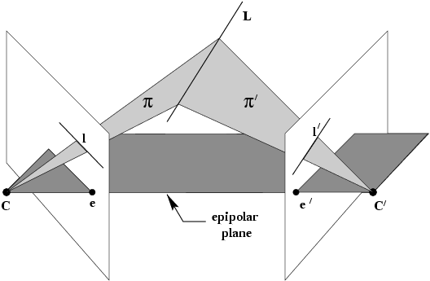
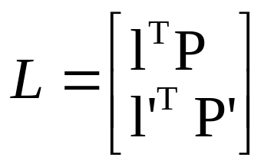
Line reconstruction
doesn‘t work for epipolar plane

Slide 15
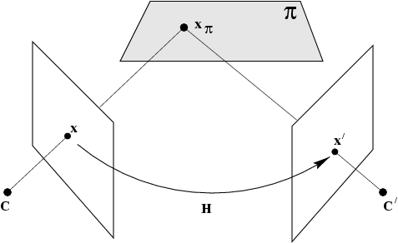
Scene planes and homographies
plane induces homography between two views

Slide 16


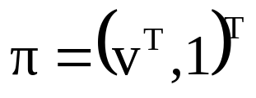

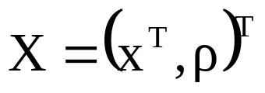
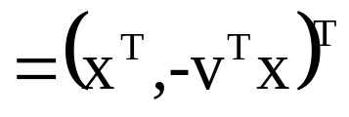
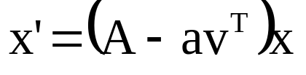


Homography given plane
point on plane
project in second view

Slide 17
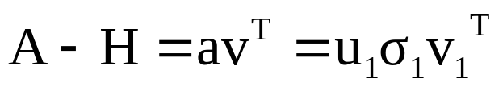
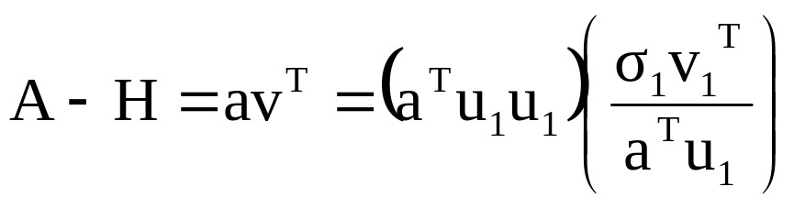
Homography given plane and vice-versa

Slide 18


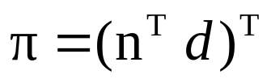

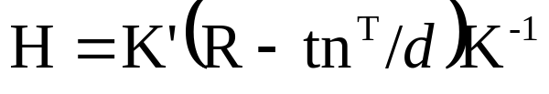
Calibrated stereo rig

Slide 19
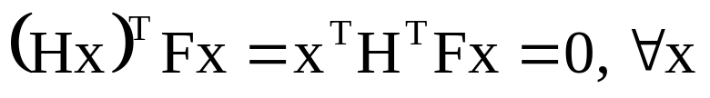


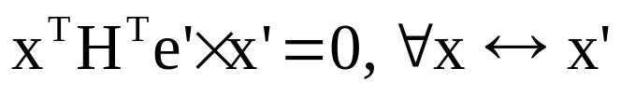

homographies and epipolar geometry
points on plane also have to satisfy epipolar geometry!
H^{T}F has to be skew-symmetric

Slide 20









homographies and epipolar geometry
(pick l_{π} =e’, since e’^{T}e’≠0)

Slide 21
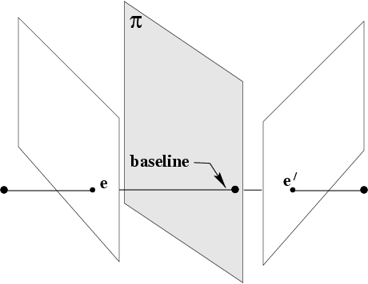
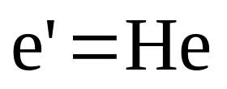
Homography also maps epipole

Slide 22
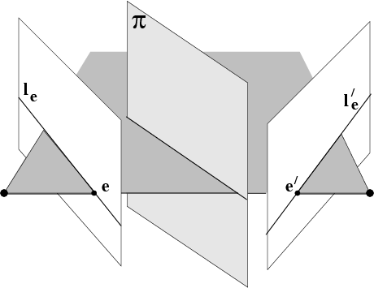
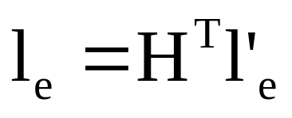
Homography also maps epipolar lines

Slide 23
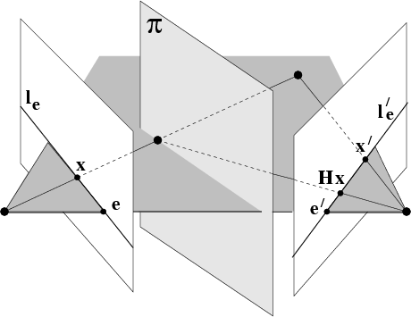
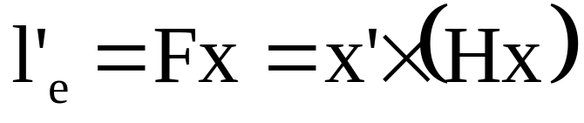
Compatibility constraint

Slide 24
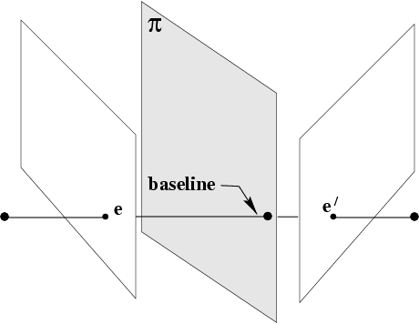
plane homography
given F and 3 points correspondences
Method 1: reconstruct explicitly,
compute plane through 3 points
derive homography
Method 2: use epipoles as 4th correspondence
to compute homography

Slide 25
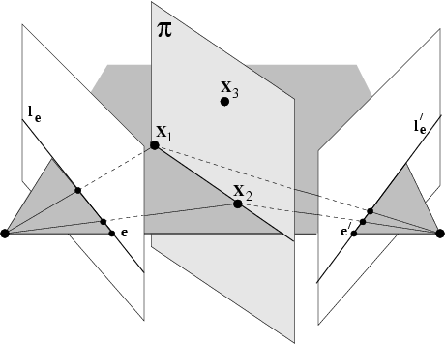
degenerate geometry for an implicit computation of the homography

Slide 26
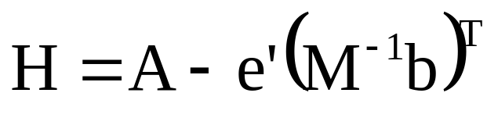
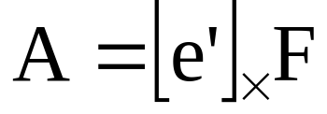
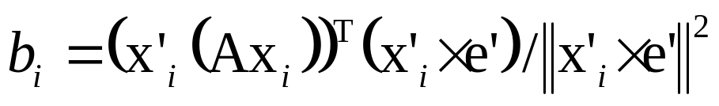
Estimastion from 3 noisy points (+F)
Consistency constraint:
points have to be in exact epipolar correspodence
Determine MLE points given F and x↔x’
Use implicit 3D approach (no derivation here)

Slide 27
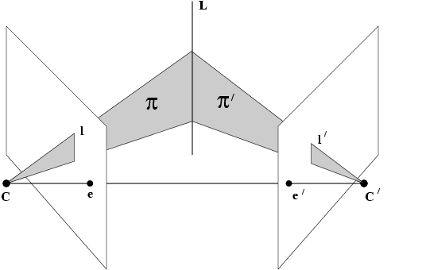
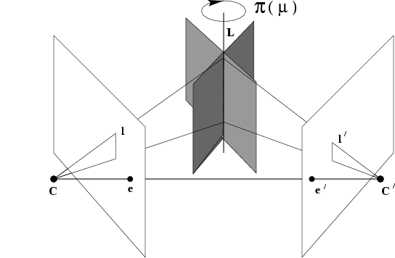
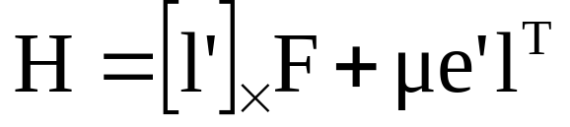
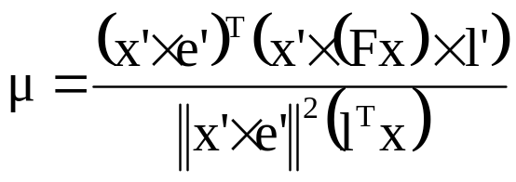
plane homography
given F, a point and a line

Slide 28
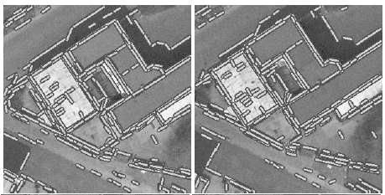
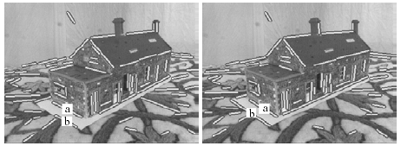
application: matching lines
(Schmid and Zisserman, CVPR’97)

Slide 29
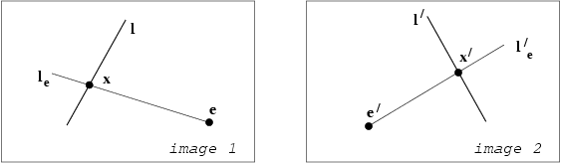
epipolar geometry
induces point homography on lines

Slide 30
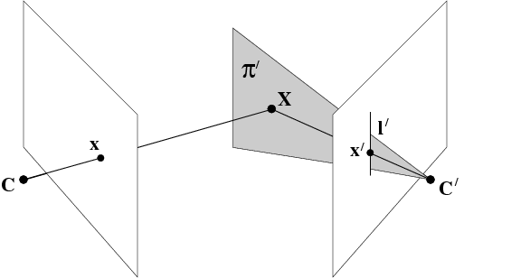

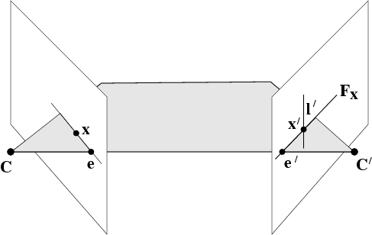
Degenerate homographies

Slide 31
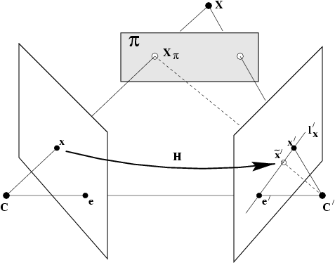


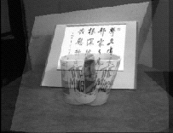
plane induced parallax

Slide 32


Slide 33



6-point algorithm
x₁,x₂,x₃,x₄ in plane, x₅,x₆ out of plane
Compute H from x₁,x₂,x₃,x₄

Slide 34


Projective depth
ρ=0 on plane
sign of ρ determines on which side of plane

Slide 35




Binary space partition

Slide 36




Two planes
H has fixed point and fixed line

Slide 37


Next class:
The Trifocal Tensor

